Slide 1
Sell It
Soft Skills
Notes:
Instructor:
Read through the whole lesson (including all the notes) before the day of class
Make note of and gather any supplies you need to bring
Prepare examples, stories
Think through how much time you want to spend on individual activities; make notes
Be sure to allow time to announce the assignment at the end
Overview:
Intro (slides 1-4): 2 minutes
Salesmanship (slides 5-9): 3 minutes
Good & Bad (slides 10-23): 15 minutes
Pitfalls (slides 24-32): 15 minutes
Sales Pitch (slides 33-43): 15 minutes
Total: 50 minutes

Slide 2
Prepare
Prepare a sales pitch on your favorite food.
Time limit: 30 seconds (timed)
Review the content in the presentation for tips on how to be persuasive.

Slide 3
Review
Compare informal to formal problem-solving
Participate in Group Scavenger Hunt to practice problem-solving by doing
Review strategies for group problem-solving (GOAL)
Notes:
What did we discuss last time?
Objectives from lesson 19

Slide 4
Outcomes
Review definitions of salesmanship
Watch good and bad examples of salesmanship
Discuss potential pitfalls in selling
Prepare and present a sales pitch

Slide 5
Salesmanship
ACME Seminar
Notes:
Overview:
Intro (slides 1-3): 2 minutes
Salesmanship (slides 4-8): 3 minutes
Good & Bad (slides 9-22): 15 minutes
Pitfalls (slides 23-31): 15 minutes
Sales Pitch (slides 32-42): 15 minutes
Total: 50 minutes

Slide 6
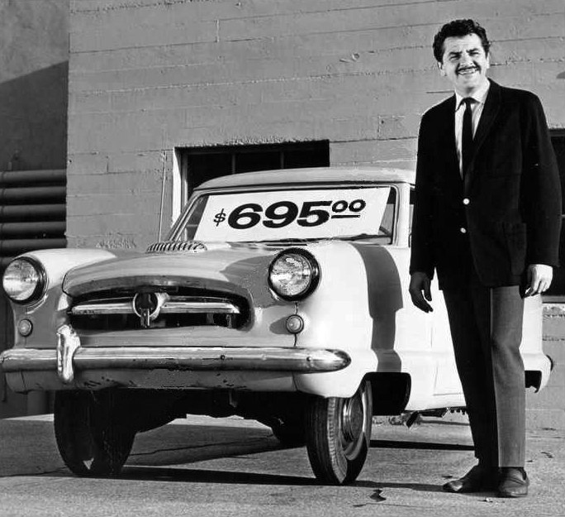
Poll
What do you think of when you hear the words “sales”, “salesman”, or “sell”?
Notes:
Image source: https://commons.wikimedia.org/wiki/File:Kovacs_special_1968.JPG

Slide 7
The truth is, most people have a terrible experiences with salesmen
Also, most people can’t close a sale—even when their job requires it
To understand how to sell, let’s first establish what selling is

Slide 8

Definition
Sale: the exchange of a commodity for money; the action of selling something.
Salesperson: a person whose job involves selling or promoting commercial products, either in a store or visiting locations to get orders.
Notes:
Content Source: https://www.google.com/webhp?sourceid=chrome-instant&rlz=1C1CHBF_enUS708US708&ion=1&espv=2&ie=UTF-8#q=definition%20of%20sales
Image source: https://www.pexels.com/photo/bazaar-booth-bracelets-candles-160227/

Slide 9
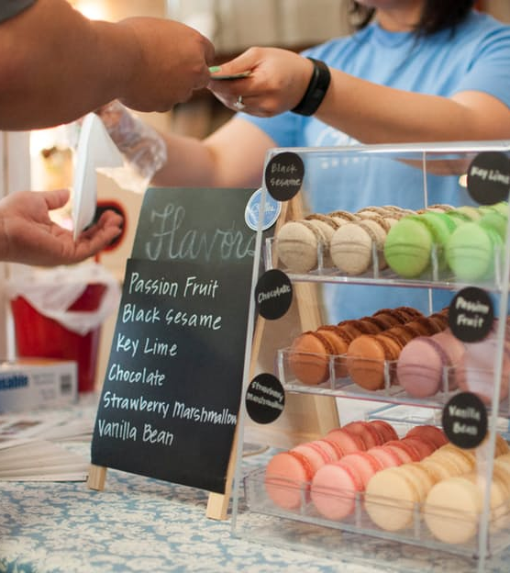
Take-away
Think of selling this way:
You have something of use, value, or importance
Other people could benefit from this thing
You explain why it is of use, value, or importance to them based on their needs
Notes:
Image source: https://www.pexels.com/photo/assorted-business-desserts-display-159991/

Slide 10
Great Salesmen & Crappy Salesmen
ACME Seminar
Notes:
Overview:
Intro (slides 1-3): 2 minutes
Salesmanship (slides 4-8): 3 minutes
Good & Bad (slides 9-22): 15 minutes
Pitfalls (slides 23-31): 15 minutes
Sales Pitch (slides 32-42): 15 minutes
Total: 50 minutes

Slide 11

Examples
One of the best ways to improve your ability to sell is to see examples—both good and bad
Look for what to replicate, and what to never do
Notes:
Image source: https://pixabay.com/en/emotions-man-happy-sad-face-adult-371238/ (CC0 license)

Slide 12
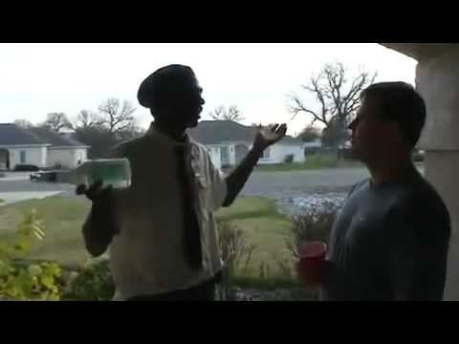
Notes:
Source: https://www.youtube.com/watch?v=LAo-DmzdvK0
Watch until the class believes that he’s the greatest salesman they’ve ever seen. It might not take long ☺

Slide 13
Reflect
What did you like about this approach?
Anything you would change?
Would it work for you?
Why or why not?

Slide 14
More Examples

Slide 15
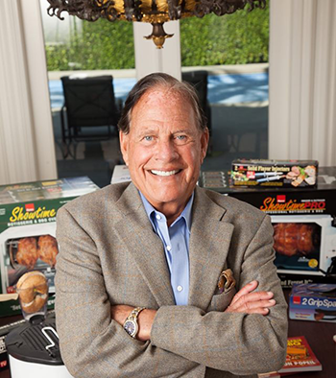
Ron Popeil
once sold over $1,000,000 in appliances in one hour on a TV special
Notes:
Image source: http://www.ronpopeil.com/
Content sources: http://www.cbsnews.com/media/the-greatest-salesmen-of-all-time/
http://www.inc.com/ss/10-greatest-salespeople-of-all-time

Slide 16
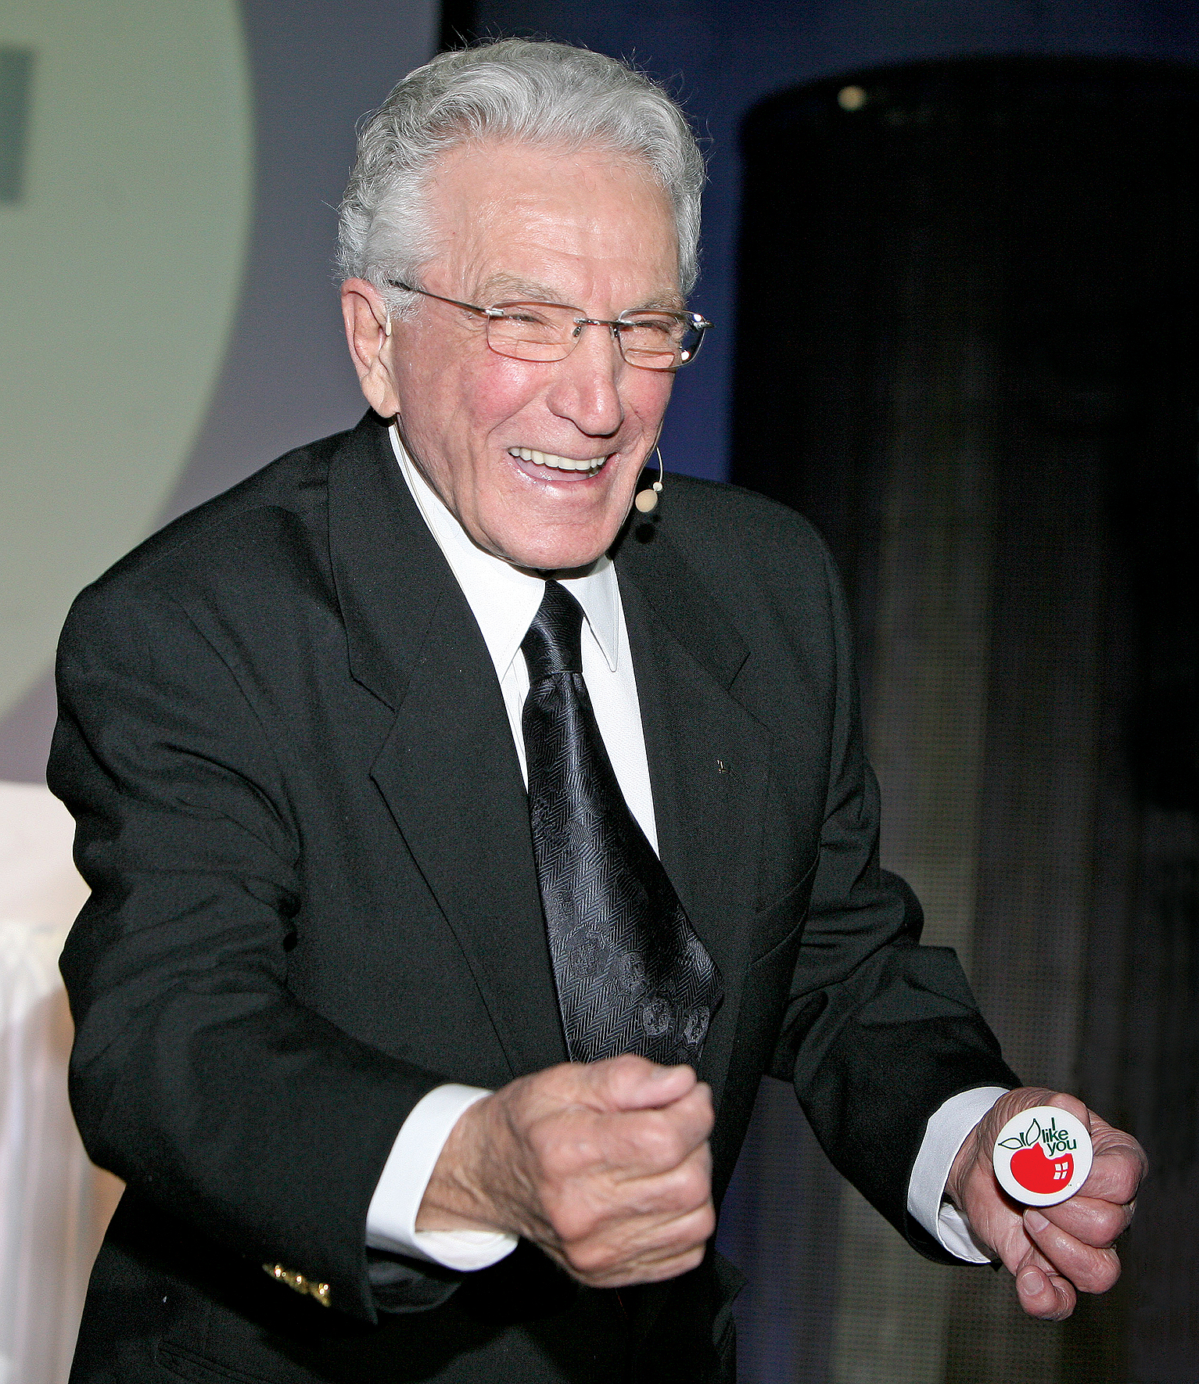
Joe Girard
sold over 13,000 cars at his Chevy dealership
Notes:
Image source: https://www.joegirard.com/wp-content/uploads/2013/05/joepoland6.jpg
Content sources: http://www.cbsnews.com/media/the-greatest-salesmen-of-all-time/
http://www.inc.com/ss/10-greatest-salespeople-of-all-time

Slide 17
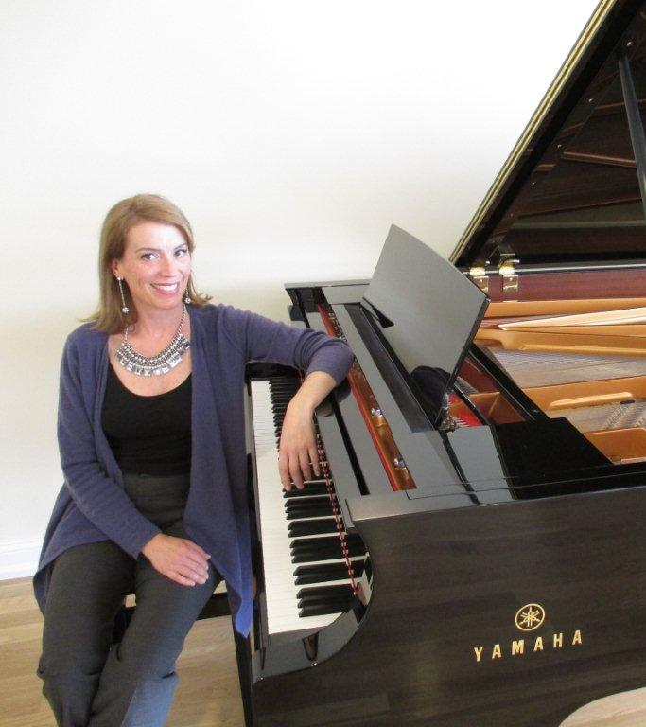
Erica Feidner
sold over $40,000,000 in pianos before retirement
customers buy from her "not because they feel pressured by her but because, after they meet her, many soon find themselves in the grip of musical ambitions they never knew they harbored. These ambitions often include buying a specific piano that they feel they can no longer live without, even if it strains both their living rooms and their bank accounts”)
Notes:
Content source: http://www.inc.com/ss/10-greatest-salespeople-of-all-time
Image source: http://www.pianomatchmaker.com/

Slide 18
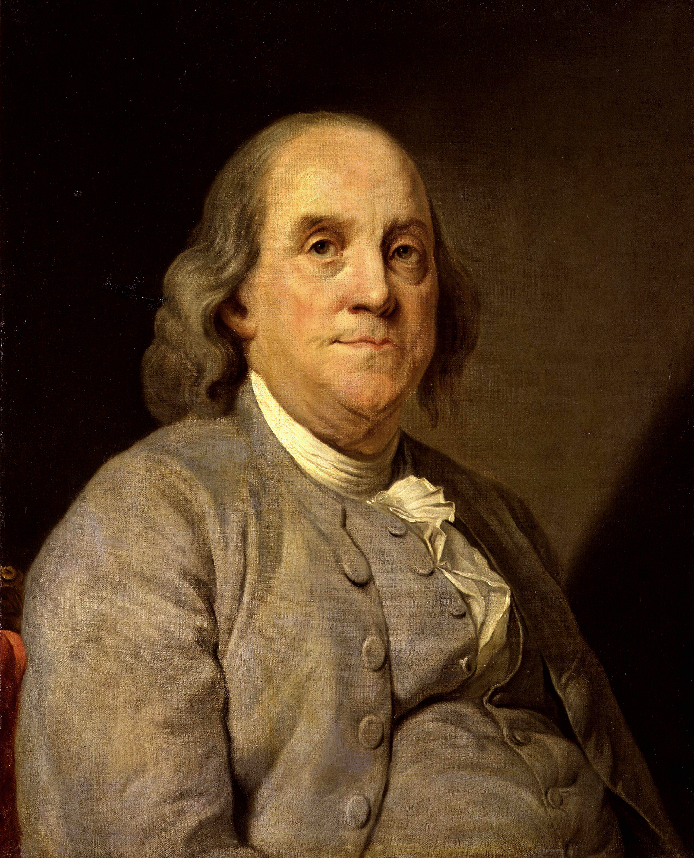
Benjamin Franklin
sold the idea of and need for the United States of America to the US and the world; pushed until the country existed
Notes:
http://www.cbsnews.com/media/the-greatest-salesmen-of-all-time/
Image source: https://commons.wikimedia.org/wiki/File:BenFranklinDuplessis.jpg

Slide 19
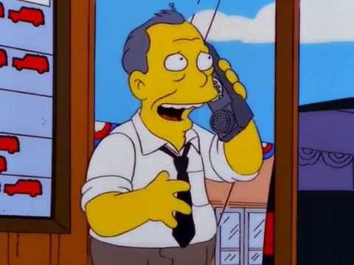
Notes:
Source: https://www.youtube.com/watch?v=2Wl4ZX4-ui8

Slide 20
Reflect
What needed to change about these approaches?
Anything that they did well?
Notes:
You could discuss both Gil and the other guy who stole his sale

Slide 21
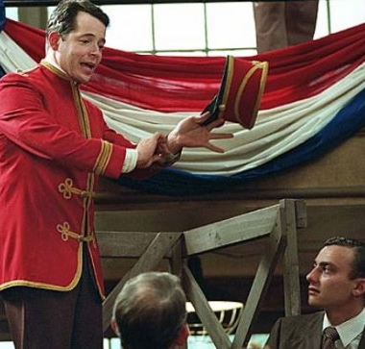
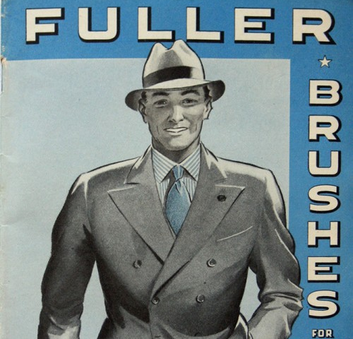
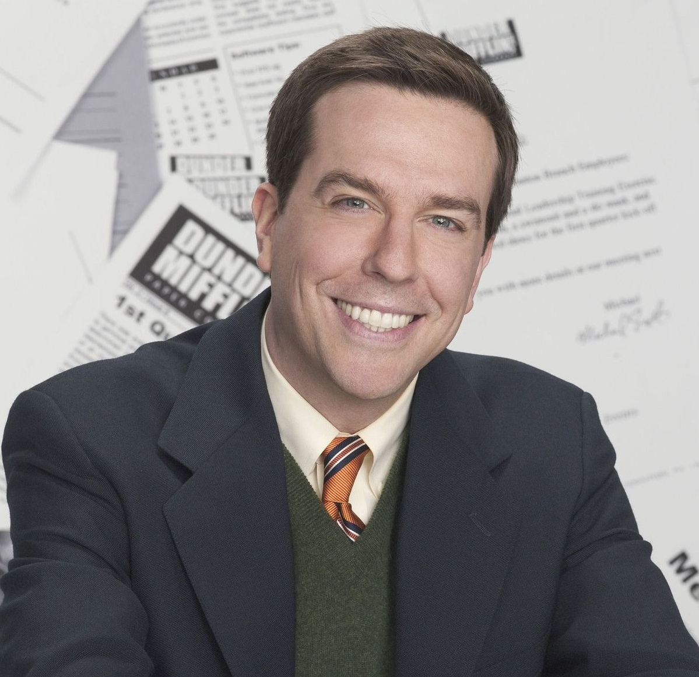

Bad examples
Harold Hill, The Music Man
The “Fuller Brush Man”
Andy Bernard, The Office
Willie Lowman, Death of a Salesman
Most used car salesmen ever
Notes:
Images:
http://theoffice.wikia.com/wiki/Andy_Bernard
http://stagedoordish.com/flashback-friday-the-music-man-marches-into-the-hearts-of-fans/
https://www.pinterest.com/lisawhannel/fuller-brush-great-bend-ks/
Keith Pattison (2010). Philip-Jackson-in-Death-o-006. Retrieved from https://www.theguardian.com/culture/2010/may/09/angel-hill-death-of-a-salesman

Slide 22
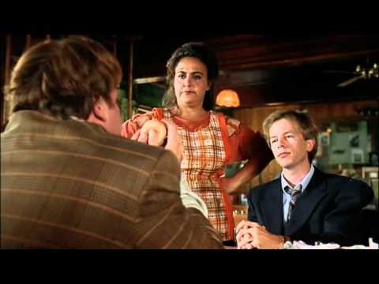
Notes:
Source: https://www.youtube.com/watch?v=xUA2EzzWAC4

Slide 23
Take-away
Be yourself.
It’s easy to spot a fake.
Watch great salesmen to improve your salesmanship

Slide 24
Pitfalls of Salesmen
ACME Seminar
Notes:
Overview:
Intro (slides 1-3): 2 minutes
Salesmanship (slides 4-8): 3 minutes
Good & Bad (slides 9-22): 15 minutes
Pitfalls (slides 23-31): 15 minutes
Sales Pitch (slides 32-42): 15 minutes
Total: 50 minutes

Slide 25
Pitfalls
Memorize these (there will be a quiz) and avoid them:
Being pushy and aggressive
Not listening / talking too much
Personal agenda (higher sales, commission, etc.)
Focusing on your wants above the customer’s needs

Slide 26
Memorized? (Quickly review with your neighbor)

Slide 27
Quiz
Write down three of the four pitfalls of salesmen.

Slide 28
Review
Some pitfalls of salesmen:
Being pushy and aggressive
Not listening / talking too much
Personal agenda (higher sales, commission, etc.)
Focusing on your wants above the customer’s needs

Slide 29
Reflect
Being pushy and aggressive
Not listening / talking too much
Personal agenda (higher sales, commission, etc.)
Focusing on your wants above the customer’s needs
Why should we avoid these things?
What experience do you have with these pitfalls?

Slide 30

Note: on Selling and Smarts
As an ACME major, you will likely encounter one other major problem: describing complicated principles to those who don’t understand them
This might be obvious, but Keep It Simple, Stupid.
If they can’t understand, the deal won’t land.
Notes:
Image source: https://pixabay.com/en/fractal-sphere-steel-3d-structures-1118515/

Slide 31
Reflect
Have you seen this concept (i.e., the need to keep it simple) in action?
How have you overcome this pitfall (i.e., unclear communication) in the past?
How can we avoid this pitfall in the future?

Slide 32
Take-away
Treat people like people, and do away with ulterior motives.
Customers will buy if their needs are met with skill and tact.

Slide 33
Sales Pitch
ACME Seminar
Notes:
Overview:
Intro (slides 1-3): 2 minutes
Salesmanship (slides 4-8): 3 minutes
Good & Bad (slides 9-22): 15 minutes
Pitfalls (slides 23-31): 15 minutes
Sales Pitch (slides 32-42): 15 minutes
Total: 50 minutes

Slide 34
Sales Pitch
Time to apply what we’ve discussed—with a sales pitch!
Prepare a 30-second pitch selling your favorite food
The facilitator will now demonstrate
Notes:
Demonstration should be 30 seconds, persuasive, engaging, etc.

Slide 35
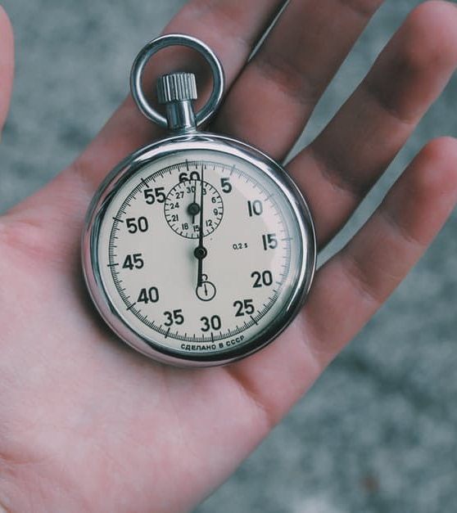
Sales Pitch
You will not have much time to sell people in the “real world”
This exercise is exaggerated to help you for the “crunch times” when you need to make a sale the most
Notes:
Image source: https://www.pexels.com/photo/pocket-watch-watch-time-stopwatch-28764/

Slide 36
Prepare 3-5 minutes A. Why would your audience want this product? B. How can you sell your product to meet their needs? C. How can you listen and respond to your audience? D. How can you be persuasive, but not pushy or annoying?

Slide 37
Round 1
We need 5 volunteers to present first.
Who thinks that their food is the most worth selling?
Facilitator: assign a timer (30 seconds each)

Slide 38
Present 30 seconds each A. What is your favorite food? B. Why should we eat it?

Slide 39
Reflect
How did they do? Do you want to eat their food?
What did they do well?
How could we improve our salesmanship?

Slide 40
Round 2
Now we need 3-5 more volunteers to present!
Who is ready to give the best sales pitch of the day?

Slide 41
Present Round 2 30 seconds each A. What is your favorite food? B. Why should we eat it?

Slide 42
Reflect
How did they do? Do you want to eat their food?
How did we improve from the last group?
How could we further improve our salesmanship?

Slide 43

Take-away
Like any important skill, selling takes practice—and it can be learned.
Keep working at this, and you will improve.
Notes:
Image from https://pixabay.com/en/woman-young-pretty-young-woman-978135/

Slide 44
Outcomes
Review definitions of salesmanship
Watch good and bad examples of salesmanship
Discuss potential pitfalls in selling
Prepare and present a sales pitch

Slide 45
Additional resources
10 Greatest Salesmen of All Time
Top books in sales (like the ones below, and more)
Who Moved My Cheese? by Spencer Johnson
Selling to Big Companies, by Jill Konrath
Mastering the Complex Sale, by Jeff Thull
Secrets of Closing the Sale, by Zig Zigler

Slide 46

Content (not images or videos) copyright information:

